Slide 1
Unit 8: Making Media Happen
SER 423

Slide 2
An Image Carousel

Slide 3
Making an Image Carousel
One of the many ways to display images is with an image carousel
A carousel has several images in it and the User slides side to side between them
The primary reason to use one is to allow the User to scroll through several images quickly
This allows you to use most or all of the View to show the image in focus
It also gives you a compact way to handle multiple images
There are many different implementations of a carousel in react
The one we’ll be focusing on is a package called react-native-snap-carousel
This is one of the more stable and versatile options

Slide 4
Setting Up the Carousel
The carousel requires a layoutType
  Default
  Stack
  Tinder
Render only needs to render the carousel itself
  The book example has a set of controls that adjust the layout of the carousel but this is not needed
The carousel itself decides the layout and size
What’s key is how it renders each item
This can simply be a View with an image component in it

Slide 5
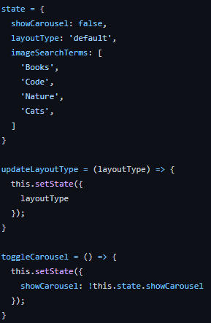
The Setup

Slide 6
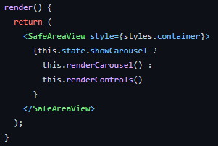
Render Itself

Slide 7
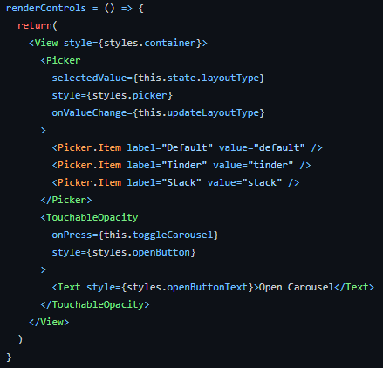
A Quick Look at Rendering the Controls

Slide 8
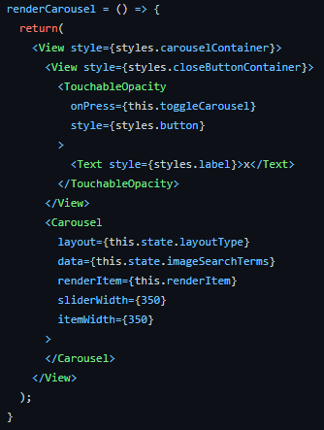
Rendering the Carousel

Slide 9
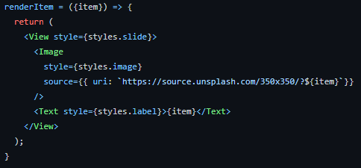
Actually Rendering an Individual Item

Slide 10
Playing Audio

Slide 11
Building an Audio Player
Fortunately, we don’t have to worry about doing anything platform specific…
… except for a few flags when we set up our audio player
This still takes a lot less work than it used to
With the carousel, we skipped doing things asynchronously, but this time we’ll do it
  Audio will take longer to load!
Our first step here will be to set up our Audio settings
We should do this in our componentDidMount hook
  This let’s us kick off the async process to load the audio right away
So, let’s set up our audio settings and start loading the audio

Slide 12
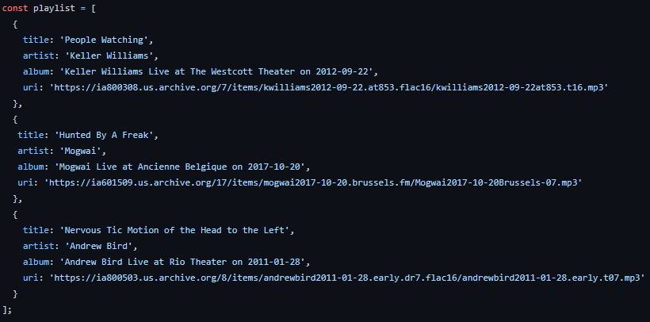
Quick Look at the Setup

Slide 13
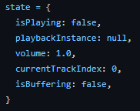
And a Quick Look at State

Slide 14
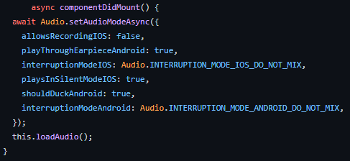
Now Let’s Look At Our Hook Set Up

Slide 15
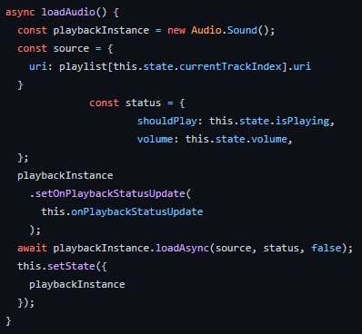
Then We Load the Audio

Slide 16
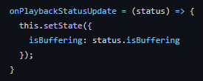
Quick Look At Status Update

Slide 17
What’s Left to do?
Well, we need to actually play the sound!
Render itself does not do a whole lot here
Based on this book example, it provides all of the control options
  Play, Pause, Next, etc.
Mainly though, it calls other functions to kick off loading another song or starting and stopping the playing through the onPress properties on buttons

Slide 18
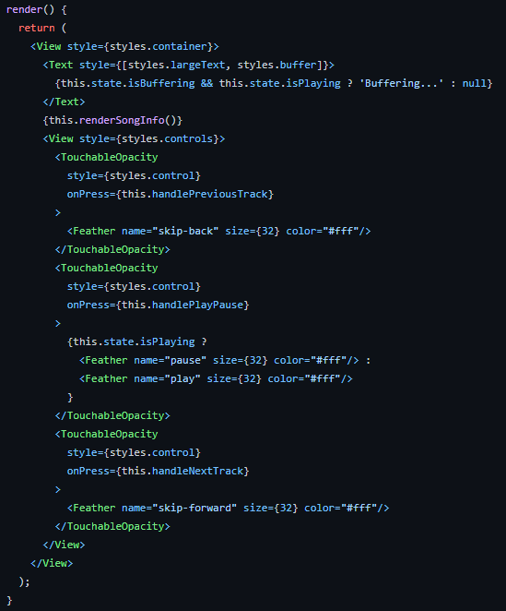
Render Itself

Slide 19
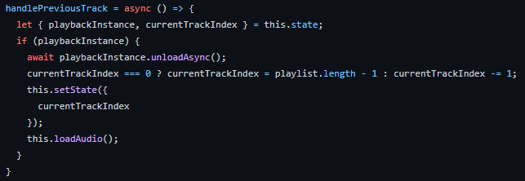
Loading New Tracks

Slide 20
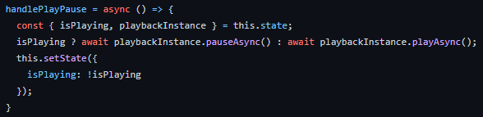
Playing and Pausing

Slide 21
End of Making Media Happen
That’s it for Module 8!

